Slide 1
BLOG
Image here of the home
NOSQL, SoSe 17 10.07.2017, Berlin
Akarsh Seggemu
Budankailu Sameer Kumar Subudhi Sonali Bhatnagar
Image here of the create blog post

Slide 2
Agenda
1.
Description
2.
Databases
3.
Live demo

Slide 3
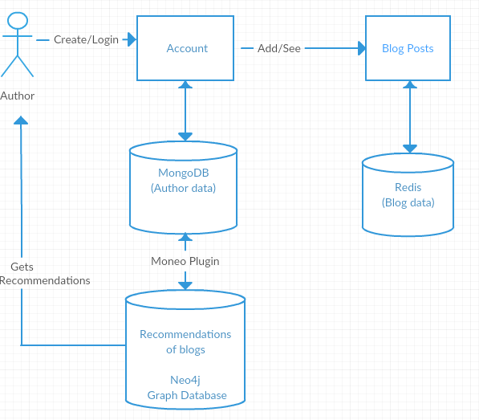
Application Architecture

Slide 4
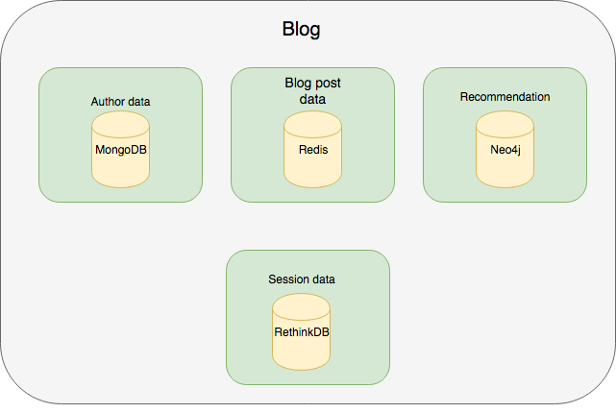
Databases: Architecture

Slide 5
NOSQL Databses: MongoDB
Mongoose
Elegant MongoDB object modeling for Node.js

Slide 6
NOSQL Databses: Redis
Stores Blog Data: Blog Title,
Category,
Blog Content
Data is key-value pair with Key as Id and Value as Blog Data

Slide 7
Redis : Problems Encountered
Data can only be stored as key value pairs
(Blog Title, Content)
What if we wish to store more fields like Category, Username?
Solution : Store data in an array

Slide 8
Redis : Problems Encountered
Unable to show latest blogs on screen when opens application first time
Open issue in Redis where first time array returns a blank value
Temporary Solution: Added an extra reload on main page

Slide 9
Advantages of Using Redis
Fast retrieval of blog data as compared to Mongo
Supporting wide variety of data types
Future advancements in application can add more complex data types like list, sets etc

Slide 10
NOSQL Databses: RethinkDB
Session storage

Slide 11
NOSQL Databses: Neo4j
Recommendation

Slide 12
Live demo

Slide 13
Questions?

